Slide 1
Chapter 3: Requirement Analysis
Requirements discovery – the process and techniques used by systems analysts to identify or extract system problems and solution requirements from the user community.
System requirement – something that the information system must do or a property that it must have. Also called a business requirement.

Slide 2
Functional vs. Nonfunctional Requirements
Functional requirement - something the information system must do
Nonfunctional requirement - a property or quality the system must have
Performance
Security
Costs

Slide 3
Results of Incorrect Requirements
The system may cost more than projected.
The system may be delivered later than promised.
The system may not meet the users’ expectations and they may not to use it.
Once in production, costs of maintaining and enhancing system may be excessively high.
The system may be unreliable and prone to errors and downtime.
Reputation of IT staff is tarnished as failure will be perceived as a mistake by the team.

Slide 4
Criteria for System Requirements
Consistent – not conflicting or ambiguous.
Complete – describe all possible system inputs and responses.
Feasible – can be satisfied based on the available resources and constraints.
Required – truly needed and fulfill the purpose of the system.
Accurate – stated correctly.
Verifiable – defined so can be demonstrated during testing.

Slide 5
Process of Requirements Discovery
Problem discovery and analysis
Requirements discovery
Documenting and analyzing requirements
Requirements Definition Document
Requirements Management

Slide 6
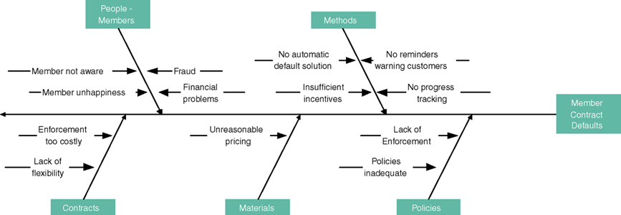
Ishikawa Diagram
Graphical tool used to identify, explore, and depict problems and the causes and effects of those problems. It is often referred to as a cause-and-effect diagram or a fishbone diagram.
Problem at right (fish head)
Possible causes drawn as "bones" off main backbone
Brainstorm for 3-6 main categories of possible causes

Slide 7
Requirements Discovery
Given an understand of problems, the systems analyst can start to define requirements.
Fact-finding – the formal process of using research, meetings, interviews, questionnaires, sampling, and other techniques to collect information about system problems, requirements, and preferences. It is also called information gathering or data collection.

Slide 8
Fact-Finding Ethics
Fact-Finding often brings systems analysts into contact with sensitive information.
Company plans
Employee salaries or medical history
Customer credit card, social security, or other information
Ethical behavior
Systems analysts must not misuse information.
Systems analysts must protect information from people who would misuse it.
Otherwise
Systems analyst loses respect, credibility, and confidence of users and management, impairing ability to do job
Organization and systems analyst could have legal liability
Systems analyst could lose job

Slide 9
Documenting and Analyzing Requirements
Documenting the draft requirements
Use cases
Decision tables
Requirements tables
Analyzing requirements to resolve problems
Missing requirements
Conflicting requirements
Infeasible requirements
Overlapping requirements
Ambiguous requirements
Formalizing requirements
Requirements definition document
Communicated to stakeholders or steering body

Slide 10
Requirements Definition Document
Requirements Definition Document – A formal document that communicates the requirements of a proposed system to key stakeholders and serves as a contract for the systems project.
Synonyms
Requirements definition report
Requirements statement
Requirements specification
Functional specifications

Slide 11
Requirements Management
Requirements management - the process of managing change to the requirements.
Over the lifetime of the project it is very common for new requirements to emerge and existing requirements to change.
Studies have shown that over the life of a project as much as 50 percent or more of the requirements will change before the system is put into production.

Slide 12
Fact-Finding Methods
Sampling of existing documentation, forms, and databases.
Gathering information by asking questions
Interviews
Questionnaires
Electronic Data Gathering

Slide 13
Fact-Finding Methods
Gathering information by Observation
Using Ethnography
Analysis by Participation
Analysis by Observation
Gathering information by Prototyping.
Interface Prototyping
Prototyping Process
Joint requirements planning (JRP).

Slide 14
Sampling Existing Documentation, Forms, & Files
Sampling –process of collecting a representative sample of documents, forms, and records.
Organization chart
Memos and other documents that describe the problem
Standard operating procedures for current system
Completed forms
Manual and computerized screens and reports
Samples of databases
Flowcharts and other system documentation
And more

Slide 15
Things to be Learned from Documents
Symptoms and causes of problems
Persons in organization who have understanding of problem
Business functions that support the present system
Type of data to be collected and reported by the system
Questions that need to be covered in interviews

Slide 16
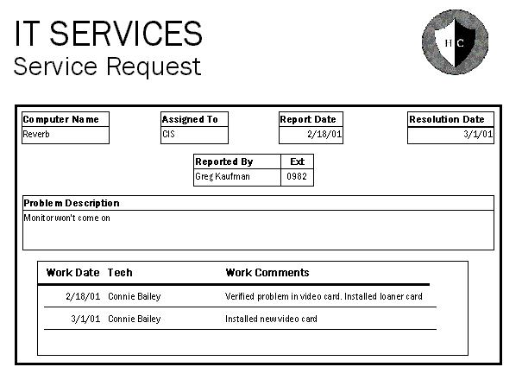
Why to Sample Completed Rather than Blank Forms
Can determine type of data going into each blank
Can determine size of data going into each blank
Can determine which blanks are not used or not always used
Can see data relationships

Slide 17
Gathering information by asking questions
Questionnaire
Interview
Electronic data gathering

Slide 18
Questionnaires
Questionnaire – a special-purpose document that allows the analyst to collect information and opinions from respondents.
Free-format questionnaire – a questionnaire designed to offer the respondent greater freedom in the answer. A question is asked, and the respondent records the answer in the space provided after the question.
Fixed-format questionnaire – a questionnaire containing questions that require selecting an answer from predefined available responses.

Slide 19
Questionnaires
Advantages
Disadvantages
Often can be answered quickly
People can complete at their convenience
Relatively inexpensive way to gather data from a large number
Allow for anonymity
Responses can be tabulated quickly
Return rate is often low
No guarantee that an individual will answer all questions
No opportunity to reword or explain misunderstood questions
Cannot observe body language
Difficult to prepare

Slide 20
Types of Fixed-Format Questions
Multiple-choice questions
Rating questions
Ranking questions
Rank the following transactions according to the amount of time you spend processing them. ___ % new customer orders ___ % order cancellations
___ % order modifications
___ % payments
The implementation of quality discounts would cause an increase in customer orders. ___ Strongly agree ___ Agree
___ No opinion
___ Disagree ___ Strongly disagree
Is the current accounts receivable report that you receive useful? ___ Yes ___ No

Slide 21
Developing a Questionnaire
Determine what facts and opinions must be collected and from whom you should get them.
Based on the facts and opinions sought, determine whether free- or fixed-format questions will produce the best answers.
Write the questions.
Test the questions on a small sample of respondents.
Duplicate and distribute the questionnaire.

Slide 22
Gathering information by Observation
Observation – a fact-finding technique wherein the systems analyst analyze the system by:
Using Ethnography
Etic view- ‘outside view’ what the system analyst sees
Emic View- ‘Inside view’ what the system users sees
Analysis by Participation
Analysis by Observation

Slide 23
Observation
Advantages
Disadvantages
Data gathered can be very reliable
Can see exactly what is being done in complex tasks
Relatively inexpensive compared with other techniques
Can do work measurements
People may perform differently when being observed
Work observed may not be representative of normal conditions
Timing can be inconvenient
Interruptions
Some tasks not always performed the same way
May observe wrong way of doing things

Slide 24
Observation Guidelines
Determine the who, what, where, when, why, and how of the observation.
Obtain permission from appropriate supervisors.
Inform those who will be observed of the purpose of the observation.
Keep a low profile.
Take notes.
Review observation notes with appropriate individuals.
Don't interrupt the individuals at work.
Don't focus heavily on trivial activities.
Don't make assumptions.

Slide 25
Gathering Information by Prototyping
Prototyping – the act of building a small-scale, representative or working model of the users’ requirements in order to discover or verify those requirements.
The main role of prototyping in ISD is to improve the requirements definition by involving potential system users

Slide 26
Gathering Information by Prototyping
Interface Prototyping
In this prototyping the screens will be developed that illustrate what users will have to do in the new system.
Prototyping Process
Prototypes can be used to describe the process that involves users. A storyboard approach can be used in this, where a series of small prototypes are tied together, so that the user can see how the whole system works

Slide 27
Gathering Information by Prototyping
Prototyping to test a new idea
Prototyping is used when a totally novel system is proposed. No early experience exists with a similar system, and so a model is needed to gain experience with the kind of problem that can be expected when developing the full-blown system

Slide 28
Gathering Information by Prototyping
Advantages
Disadvantages
Can experiment to develop understanding of how system might work
Aids in determining feasibility and usefulness of system before development
Serves as training mechanism
Aids in building test plans and scenarios
May minimize time spent on fact-finding
Developers may need to be trained in prototyping
Users may develop unrealistic expectations
Could extend development schedule

Slide 29
Interviews
Interview - a fact-finding technique whereby the systems analysts collect information from individuals through face-to-face interaction.
Find facts
Verify facts
Clarify facts
Generate enthusiasm
Get the end-user involved
Identify requirements
Solicit ideas and opinions
The personal interview is generally recognized as the most important and most often used fact-finding technique.

Slide 30
Types of Interviews and Questions
Unstructured interview –conducted with only a general goal or subject in mind and with few, if any, specific questions. The interviewer counts on the interviewee to provide a framework and direct the conversation.
Structured interview –interviewer has a specific set of questions to ask of the interviewee.
Open-ended question – question that allows the interviewee to respond in any way.
Closed-ended question – a question that restricts answers to either specific choices or short, direct responses.

Slide 31
Interviews
Advantages
Disadvantages
Give analyst opportunity to motivate interviewee to respond freely and openly
Allow analyst to probe for more feedback
Permit analyst to adapt or reword questions for each individual
Can observe nonverbal communication
Time-consuming
Success highly dependent on analyst's human relations skills
May be impractical due to location of interviewees

Slide 32
Procedure to Conduct an Interview
Select Interviewees
End users
Learn about individual prior to the interview
Prepare for the Interview
interview guide
Conduct the Interview
Summarize the problem
Offer an incentive for participation
Ask the interviewee for assistance
Follow Up on the Interview
Memo that summarizes the interview

Slide 33
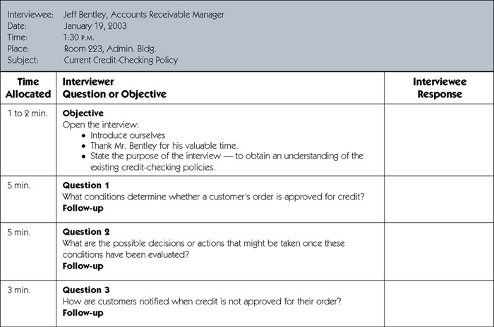
Sample Interview Guide
(continued)

Slide 34
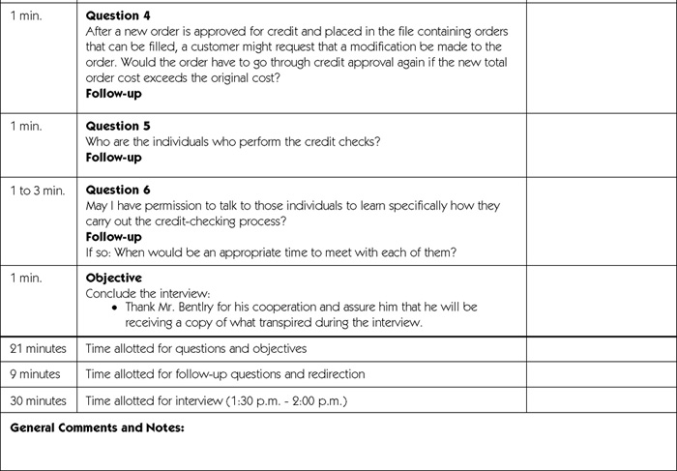
Sample Interview Guide (concluded)

Slide 35
Prepare for the Interview
Types of Questions to Avoid
Loaded questions
Leading questions
Biased questions
Interview Question Guidelines
Use clear and concise language.
Don’t include your opinion as part of the question.
Avoid long or complex questions.
Avoid threatening questions.
Don’t use “you” when you mean a group of people.

Slide 36
Conduct the Interview
Dress to match interviewee
Arrive on time
Or early if need to confirm room setup
Open interview by thanking interviewee
State purpose and length of interview and how data will be used
Monitor the time
Ask follow-up questions
Probe until you understand
Ask about exception conditions ("what if...")

Slide 37
Interviewing Do’s and Don’ts
Do
Don't
Dress appropriately
Be courteous
Listen carefully
Maintain control of the interview
Probe
Observe mannerisms and nonverbal communication
Be patient
Keep interviewee at ease
Maintain self-control
Finish on time
Assume an answer is finished or leading nowhere
Reveal verbal and nonverbal clues
Use jargon
Reveal personal biases
Talk more than listen
Assume anything about the topic or the interviewee
Tape record (take notes instead)

Slide 38
Body Language and Proxemics
Body language – the nonverbal information we communicate.
Facial disclosure
Eye contact
Posture

Slide 39
Joint Requirements Planning
Joint requirements planning (JRP) – a process whereby highly structured group meetings are conducted for the purpose of analyzing problems and defining requirements.
JRP is a subset of a more comprehensive joint application development or JAD technique that encompasses the entire systems development process.

Slide 40
JRP Participants
Sponsor
Facilitator
Users and Managers
Scribes
IT Staff

Slide 41
Steps to Plan a JRP Session
Selecting a location
Away from workplace when possible
Requires several rooms
Equipped with tables, chairs, whiteboard, overhead projectors
Needed computer equipment
Selecting the participants
Each needs release from regular duties
Preparing the agenda
Briefing documentation
Agenda distributed before each session

Slide 42
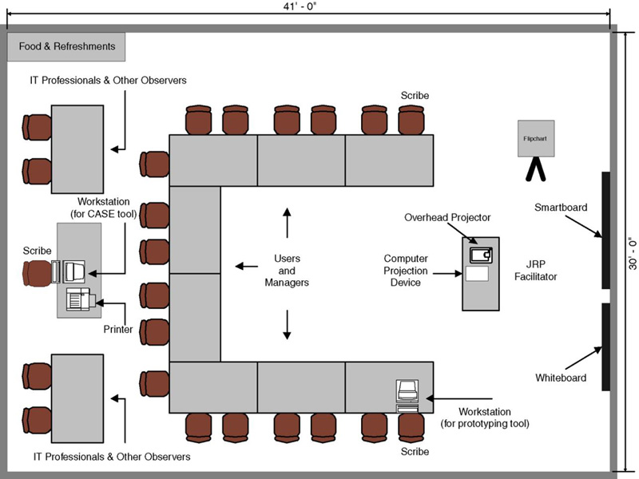
Typical Room Layout for JRP session

Slide 43
Guidelines for Conducting a JRP Session
Do not unreasonably deviate from the agenda
Stay on schedule
Ensure that the scribe is able to take notes
Avoid the use of technical jargon
Apply conflict resolution skills
Allow for ample breaks
Encourage group consensus
Encourage user and management participation without allowing individuals to dominate the session
Make sure that attendees abide by the established ground rules for the session

Slide 44
Brainstorming
Sometimes, one of the goals of a JRP session is to generate possible ideas to solve a problem.
Brainstorming is a common approach that is used for this purpose.
Brainstorming – a technique for generating ideas by encouraging participants to offer as many ideas as possible in a short period of time without any analysis until all the ideas have been exhausted.

Slide 45
Brainstorming Guidelines
Isolate appropriate people in a place that free from distractions and interruptions.
Make sure everyone understands purpose of the meeting.
Appoint one person to record ideas.
Remind everyone of brainstorming rules.
Within a specified time period, team members call out their ideas as quickly as they can think of them.
After group has run out of ideas and all ideas have been recorded, then and only then should ideas be evaluated.
Refine, combine, and improve ideas generated earlier.

Slide 46
Benefits of JRP
JRP actively involves users and management in the development project (encouraging them to take “ownership” in the project).
JRP reduces the amount of time required to develop systems.
When JRP incorporates prototyping as a means for confirming requirements and obtaining design approvals, the benefits of prototyping are realized

Slide 47
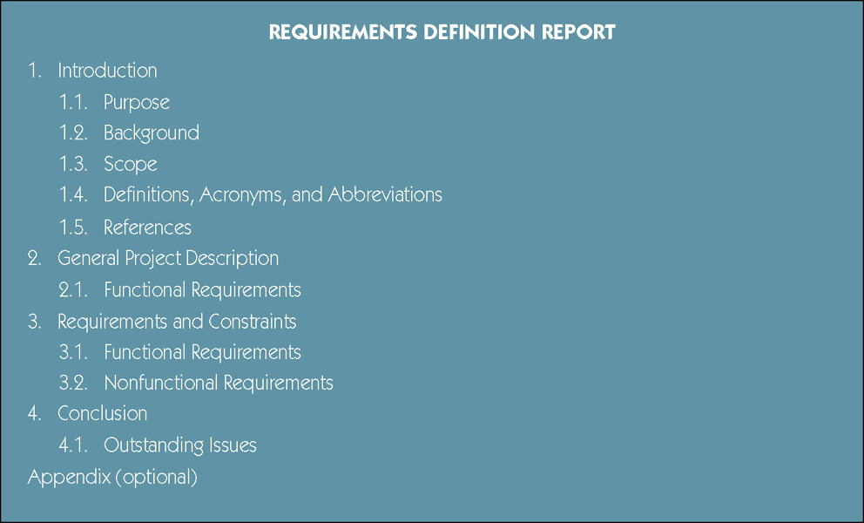
Sample Requirements Definition Report Outline

